Slide 1
Test framework 1.0.1
Dragos Puscasu
Automation tester
Dragos.Puscasu@endava.com
Notes:
JUnit is a unit testing framework for Java programming language. JUnit has been important in the development of test-driven development, and is one of a family of unit testing frameworks collectively known as xUnit, that originated with JUnit.
need to add a small speech!!!

Slide 2

Agenda
Junit
Selenium WebDriver
Cucumber-JVM
Notes:
JUnit is a unit testing framework for Java programming language. JUnit has been important in the development of test-driven development, and is one of a family of unit testing frameworks collectively known as xUnit, that originated with JUnit.
need to add a small speech!!!

Slide 3
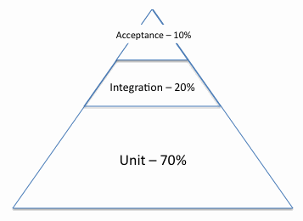

Slide 4

Key features
Provides annotations to identify test methods.
Provides assertions for testing expected results.
Provides test runners for running tests.
Notes:
JUnit is a unit testing framework for Java programming language. JUnit has been important in the development of test-driven development, and is one of a family of unit testing frameworks collectively known as xUnit, that originated with JUnit.
need to add a small speech!!!
mvn test -Denv="junit"

Slide 5
Junit
Pre-requisites:
-Java 1.6 or later
-Maven 3.2.5 or later
-Intellij IDEA 12 or later
Recommended version: junit 4.12

Slide 6
Junit API
Assert - A set of assert methods.
TestCase - A test case defines the fixture to run multiple tests.
TestSuite - A TestSuite is a composite of tests.
Notes:
Among others…..need to add a small speech
Junit API overview - http://junit.org/junit4/javadoc/latest/
The API containes about 150 classes grouped in 20 packages
Packages (matchers, rules, validator,runners – with variations – manipulation,notification,parameterized; )
Classes – Before,After,Assert, TestCase(annotation), TestSuite , Test result

Slide 7
Junit API - Assert
void assertEquals(boolean expected, boolean actual)
Checks that two primitives/objects are equal.
void assertFalse(boolean condition)
Checks that a condition is false.
void assertNotNull(Object object)
Checks that an object isn't null.
void assertNull(Object object)
Checks that an object is null.
void assertTrue(boolean condition)
Checks that a condition is true.
void fail()
Fails a test with no message.
Notes:
Assert is the final reason for why we do the test.
Fail() – because sometimes you just want the test to fail..no matter the reason. Just to screw with the developer :D
Bineinteles avem si fail(String message )
Fail is used for soft assertion. – interview question
Reference: https://www.tutorialspoint.com/junit/junit_api.htm

Slide 8
Junit API - Testcase
void setUp()
Sets up the fixture, for example, open a network connection.
void tearDown()
Tears down the fixture, for example, close a network connection.
TestResult run()
A convenience method to run this test, collecting the results with a default TestResult object.

Slide 9
Junit API - TestSuite
void addTest(Test test)
Adds a test to the suite.
void addTestSuite(Class<? extends TestCase> testClass)
Adds the tests from the given class to the suite.
int countTestCases()
Counts the number of test cases that will be run by this test.
int testCount()
Returns the number of tests in this suite.
static Test warning(String message)
Returns a test which will fail and log a warning message.
void run(TestResult result)
Runs the tests and collects their result in a TestResult.

Slide 10
Junit - Annotations
Usual suspects:
@Test - identifies a method as a test method.
@Before - method is executed before each test.
@After - method is executed after each test.
@Ignore – method will be ignored when running the test suite
Notes:
Before – BeforeClass
After – AfterClass
Use *Class for one time use in that class
Example : setup selenium server – but for a specific test/class you need some desired capabilities for the browse(IE – comptatibility mode)

Slide 11

Notes:
Prezentare aplicatie calculator – do tests toate de la 0
Prezentare sortare – do tests la toate
Prezentare regex exemplu – do tests la toate

Slide 12

Notes:
Short introduction about cucumber si ce face el….
De ce JVM? 0- origini ruby

Slide 13
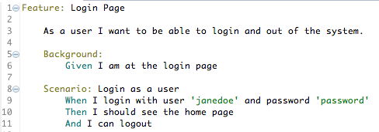
Gherkin
Notes:
The Gherkin language is the most widely used and recognised business-readable, domain-specific language (DSL) for specifying behaviours. Each behaviour is defined as an individual "Scenario". A "Scenario" has a description that summarises the behaviour being specified. The behaviour is then further defined as a series of steps to be executed in the order in which they are written — just like the steps of a test case.
The syntax of the Gherkin language specifies that each step begins with one of the following keywords: "Given", "When", "Then", "And" or "But". The "Given" steps must be specified before the "When" steps, which themselves must be specified before the "Then" steps. The "Given" steps define the prerequisite state that is required for the behaviour to manifest. The "When" steps define how to initiate the behaviour being specified. The "Then" steps define how to verify that the behaviour performed as expected. Steps that begin with "And" or "But" merely allow for more details to be specified and extend the meaning of the proceeding "Given", "When" or "Then" step.

Slide 14
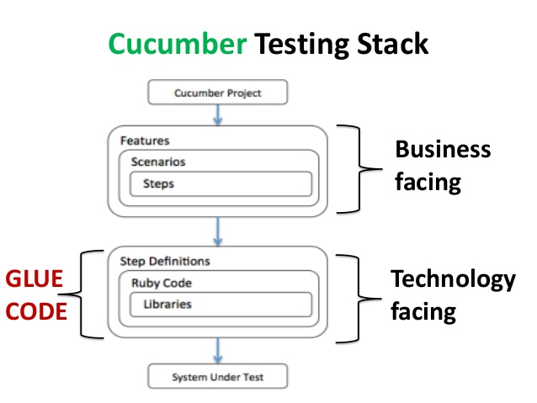

Slide 15
Cucumber advantages
Cucumber supports different languages like Java.net and Ruby.
It acts as a bridge between the business and technical language. We can accomplish this by creating a test case in plain English text.
It allows the test script to be written without knowledge of any code, it allows the involvement of non-programmers as well.
It serves the purpose of end-to-end test framework unlike other tools.
Due to simple test script architecture, Cucumber provides code reusability.

Slide 16
Keywords
Feature − Name of the feature under test.
Description (optional) − Describe about feature under test.
Scenario − What is the test scenario.
Given − Prerequisite before the test steps get executed.
When − Specific condition which should match in order to execute the next step.
Then − What should happen if the condition mentioned in WHEN is satisfied.
Notes:
Plus Background ; scenario outline, And

Slide 17
Tips and tricks
Scenario Outline - replaces variable/keywords with the value from the table. Each row in the table is considered to be a scenario.
Background -Background generally has the instruction on what to setup before each scenario runs.
Tags – “@SmokeTest”
Glue – define the location where the steps are defined
Comments – in the feature file use “#”

Slide 18


Slide 19


Slide 20
Short history
Selenium IDE
Selenium standalone server
Selenium 2 WebDriver
Selenium 3

Slide 21
Selenium Simplified
Bindings
Java
C#
Ruby
Python
Node
Drivers
Chrome
Firefox
InternetExplorer
Safari
Webdriver API
Browser
Notes:
http://www.seleniumhq.org/download/

Slide 22
Selenium Drivers
HTML Unit Driver
Firefox Driver
Chrome Driver
Internet Explorer Driver
Notes:
And others : iOS driver, Selendroid, Appium, windows phone, Microsoft Edge, etc
http://www.seleniumhq.org/download/

Slide 23
WebDriver API
get(String url)
Load a new web page in the current browser window. This is done using an HTTP GET operation, and the method will block until the load is complete.
getTitle()
Returns title of current page
findElements(By by)
Finds all elements in current page using locators
getWindowHandles()
Returns a set of windows handle to manage windows/pop-ups
Close()
Closes the current window of the browser.
Quit()
Quits the driver with all associated windows
Notes:
https://seleniumhq.github.io/selenium/docs/api/java/org/openqa/selenium/WebDriver.html
https://www.w3.org/TR/webdriver/

Slide 24
WebElement API
click()
Click this element
getText()
Returns text of the current element
findElements(By by)
Finds all elements in current page using locators
sendKeys(String)
Simulates typing into an element
isDisplayed
Determine whether or not this element is displayed or not.
submit()
If this current element is a form, or an element within a form, then this will be submitted to the remote server
Notes:
https://seleniumhq.github.io/selenium/docs/api/java/org/openqa/selenium/WebElement.html

Slide 25


Slide 26
Documentation
Junit
https://www.tutorialspoint.com/junit/index.htm
https://examples.javacodegeeks.com/core-java/junit/junit-best-practices/
http://junit.org/junit4/javadoc/latest/index.html?overview-summary.html
Selenium
http://www.seleniumhq.org/
https://www.tutorialspoint.com/selenium/index.htm
http://toolsqa.com/selenium-tutorial/
Cucumber
https://www.tutorialspoint.com/cucumber/index.htm
https://saucelabs.com/blog/write-great-cucumber-tests

